Slide 1
Foods and Beverages flavors Business Overview of North America region

Slide 2
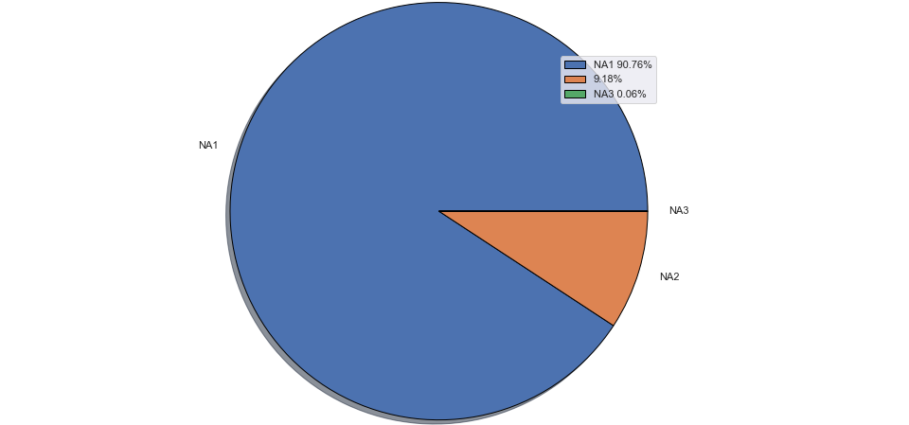
Classifying the regions
Market Subcategory
Approach for each country
Market subcategory with highest number Flavor
Market subcategory with lowest number Flavor
Flavor Group
Position Group
Highest Flavor Type
Highest Position Type
Assuming the North America has only three countries NA1,NA2,NA3
Most of the Business comes from the NA1(90.18% assuming the flavors there in market are performing good)
There is only 1 business product which has its sales in NA3 country.
The NA3 Country has only one product which has Market subcategory of Carbonates and was launched in 2008 with the Flavor Group of Alcohol

Slide 3
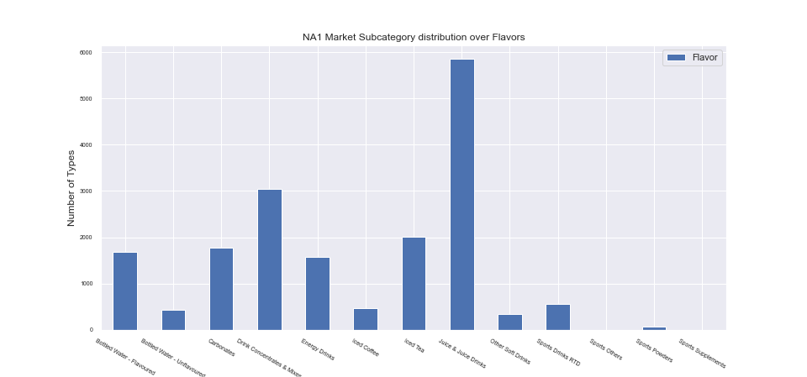
Business overview of NA1
Juice & Juice Drinks
Sports
The NA1 has products availability from all the available marketing subcategory.
The total number of Flavors NA1 has is 4980 flavors across all the flavor groups
The maximum number of flavors available for the NA1 is Juice and Juice Drinks (JJD)
And the NA1 market has very low product of the sports category consisting of all 4 marketing category

Slide 4
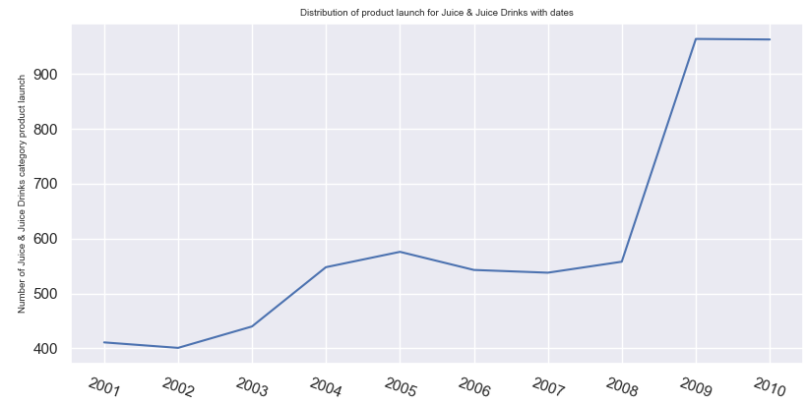
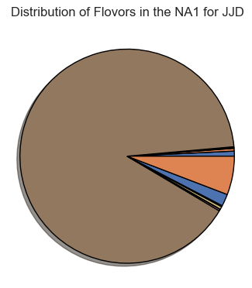
Focusing on Juice and Juice Drinks (JJD) (Considering Flavor)
70% are Fruits
Fruits
90.2%
Others
The largest numbers of flavor are present in the JJD category , so its fair to assume that this category must be large source of revenue and profits NA1 and that can be seen from the uptrend of number of various flavors launched in 2009 and 2010
For the Category of JJD almost 90.2% of the flavor group is fruits and 70% of these 90.2% were launched within the span of 2009 and 2010 as shown

Slide 5
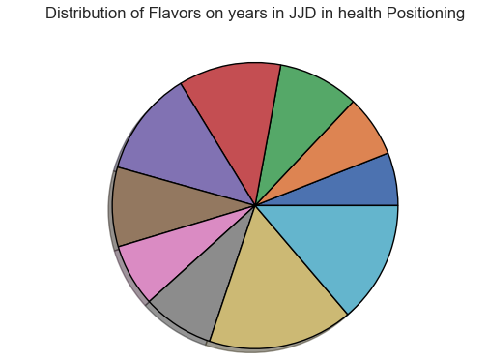
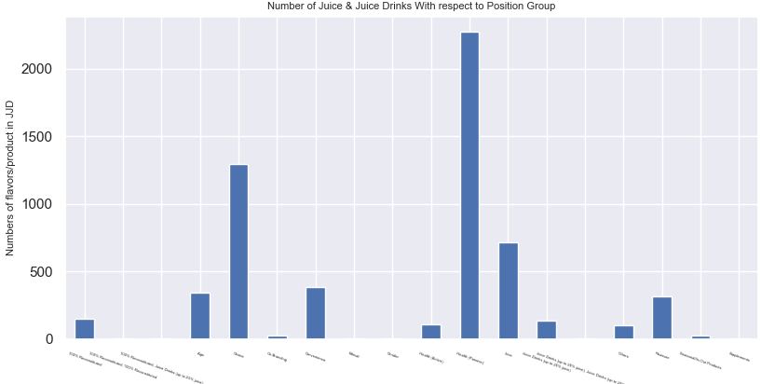
Focusing on JJD(Considering Positioning)
Choice
Health
13.8%
16.4%
2010
2009
The plot shows the distribution of JJD with the positioning group , which clearly shows that almost 40.41% of the JJD are from the Health category (both Active and Passive) followed by Choice contributing 22% in JJD distribution in total covering more than 60% of the JJD Business
As the plot of distribution of product launch across different dates shows , The flours for health position group has also increased in the last 2 years i.e 2009 and 2010 as shown above

Slide 6
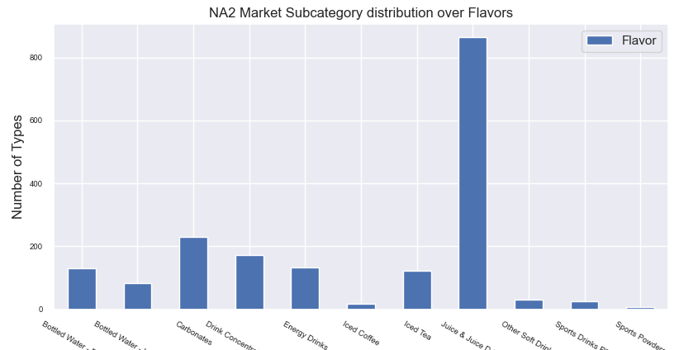
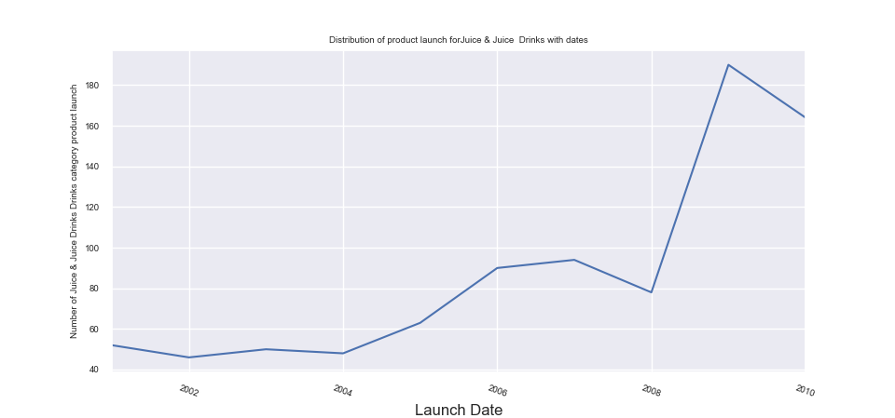
Business overview of NA2
The Data distribution of number of types of flavors with respect to Market subcategory looks exactly similar to the NA1
NA2 has zero products flavors from Sport Others and Sports Supplement.
The source of revenue (considering uniform product price across every market subcategory) is JJD in NA2
The sports section has the lowest numbers of flavors in NA2 as well which looks same as that of NA1
The Line graph shows the increased investment in launching the new flavors in JJD in last 2 years (2009,2010)

Slide 7
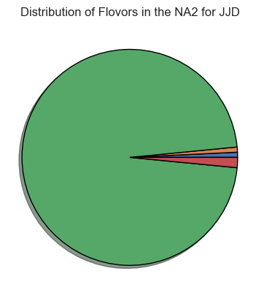
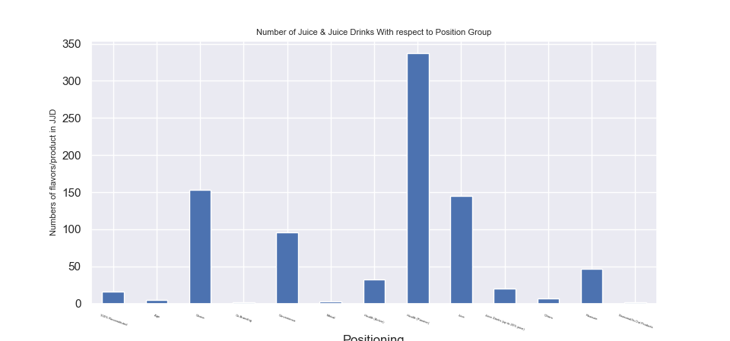
NA2 Flavor and Positioning Distribution in JJD
Health
others
Fruits
Flavor
Positioning
The distribution of JJD in NA2 is similar , the only differences we have here is the JJD is consisting of almost 98% of Fruits as compared with 90.2% of NA1
The JJD in NA2 stands in the positioning of Health only same as that of NA1, The Positioning that JJD does not cover in NA2 are Supplements and Gender

Slide 8
Conclusion
Assuming the Business from NA1 and NA2 has similar distribution across all segments and flavors and positions we can have the following conclusion
Looking at the data from NA2 and NA1 the maximum revenue is coming from the Juice and Juice Drinks
The distribution of flavor with respect to Flavor group in JJD is almost 90% contributed by Fruits
The distribution of flavor with respect to Positioning group in JJD is almost 60% contributed by Health and Choice.
The most focused and emerging investment that the business is doing is into Juice and Juice drinks followed by Drink Concentrates and Mixtures for NA1 and Carbonates for NA2
We can perform similar analysis on the market subcategory where number of flavors are minimum (Sports) for both NA1 and NA2

Slide 9
Launching new product
We can consider following points for answering the given market entry case(some of them are points and some of them are questions):
1.We want to enter in which country?
2.The flavor that is being consumed in NA1 and NA2 is Fruits and Tea (>80%)
3.We need to see if the production of the JJD can be used for production of the Iced Tea.
4.The data for the price sensitivity is another concern for launching the products in Ice Tea category
5. The Market share we want to capture in the Ice Team market
6.Can we leverage the production of Ice Tea by other products?
7.Data regarding the Competition in the market

